Slide 1



Test-Time Domain Adaptation by Learning Domain-Aware Batch Normalization
Yanan Wu* Zhixiang Chi* Yang Wang Konstantinos N. Plataniotis Songhe Feng

Slide 2
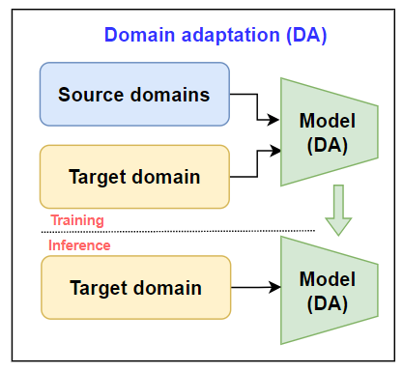
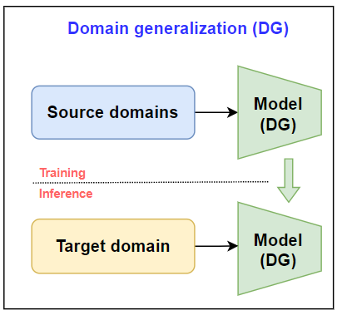
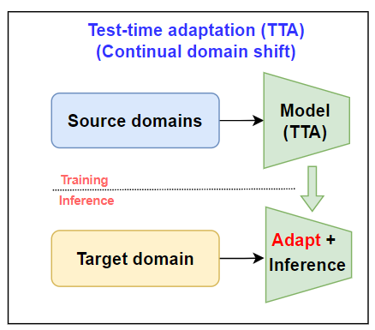
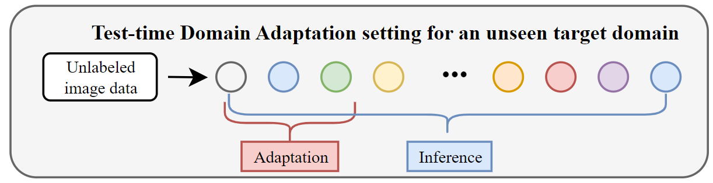
Problem setting for Test-Time Domain Adaptation (TT-DA)
(-) Require huge amount of unlabeled target data
(-) Large-scale repetitive training
(+) One model to tackle all domains
(-) Fail to exploit domain specific information in target domains
(+) Exploit domain specific information in unseen target domains
(+) For each target domain, only adapt once using few unlabeled data
Assumption: few unlabeled data convey the underlying distribution of that domain.

Slide 3
Challenges in TT-DA
We seek a simple yet effective solution for CNN-based networks
To update from few-shot unlabeled data:
Which parameters to update?
How to determine the supervision?
Effective training strategy?

Slide 4
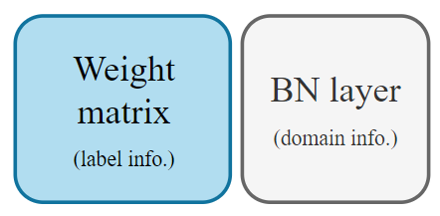
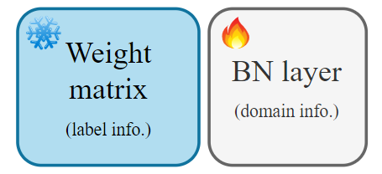
Knowledge Disentanglement
Intuition for TT-DA:
All domains share the label space.
Share semantic information.
Every data in a domain is drawn from the same distribution. (e.g., same style of drawing)
Require domain-specific knowledge.
Prior research on knowledge disentanglement [1]:
Label information -> weight matrix
Domain information -> BN layer
Keep the well-acquired label knowledge undisturbed
Maximize domain-specific knowledge extraction
[1] Li et al. Revisiting batch normalization for practical domain adaptation, ICLR 2016.

Slide 5
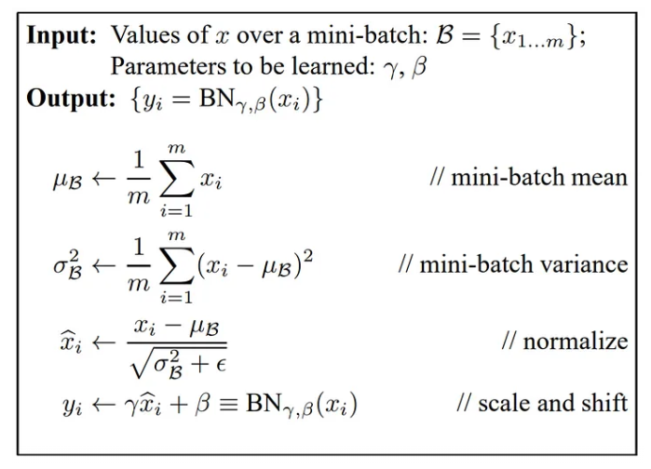

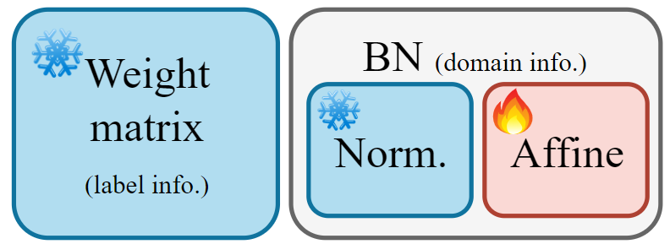
Learning Domain-specific Knowledge
Batch normalization:
Normalization
Unstable on few-shot data.
Affine transformation (learnable)
Directly adopt normalization statistics from source data.
Use affine parameters for correction.

Slide 6
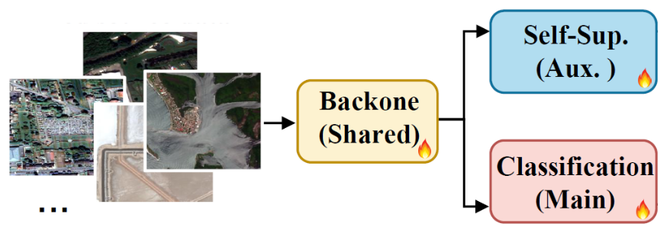
Supervision?
Recap:
Unlabeled data
Extract domain information only
Class-independent self-supervised loss
Auxiliary branch
Misalignment
Primary branch
Formulate the learning pipeline as multi-task learning
Network updated via auxiliary branch benefits the main branch

Slide 7
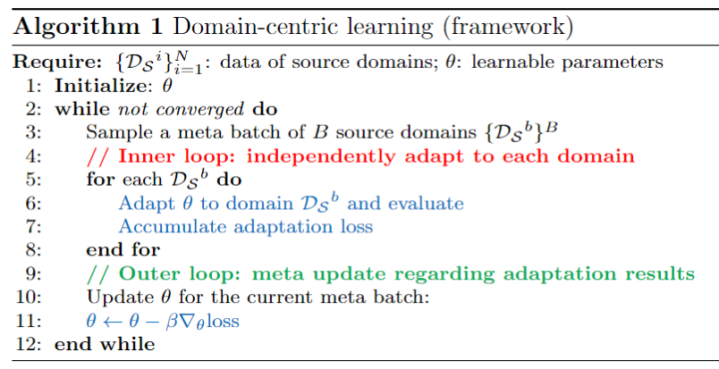
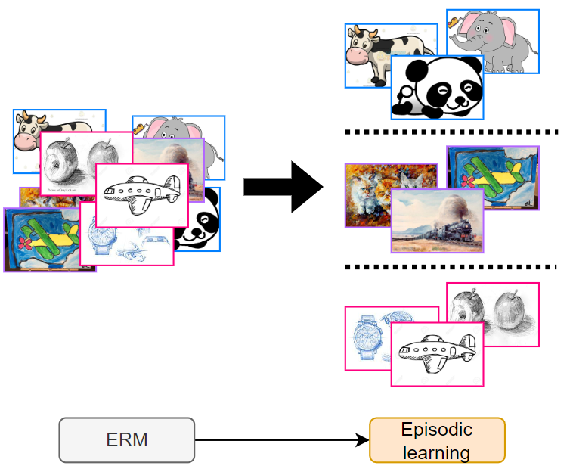
Domain-centric Learning to Adapt
Goal:
Focus on the domain-level rather than the dataset/instance level.
Enforce to learn the domain-specific knowledge
Learning objective alignment (bi-level optimization)
*Methods and setting-dependent

Slide 8
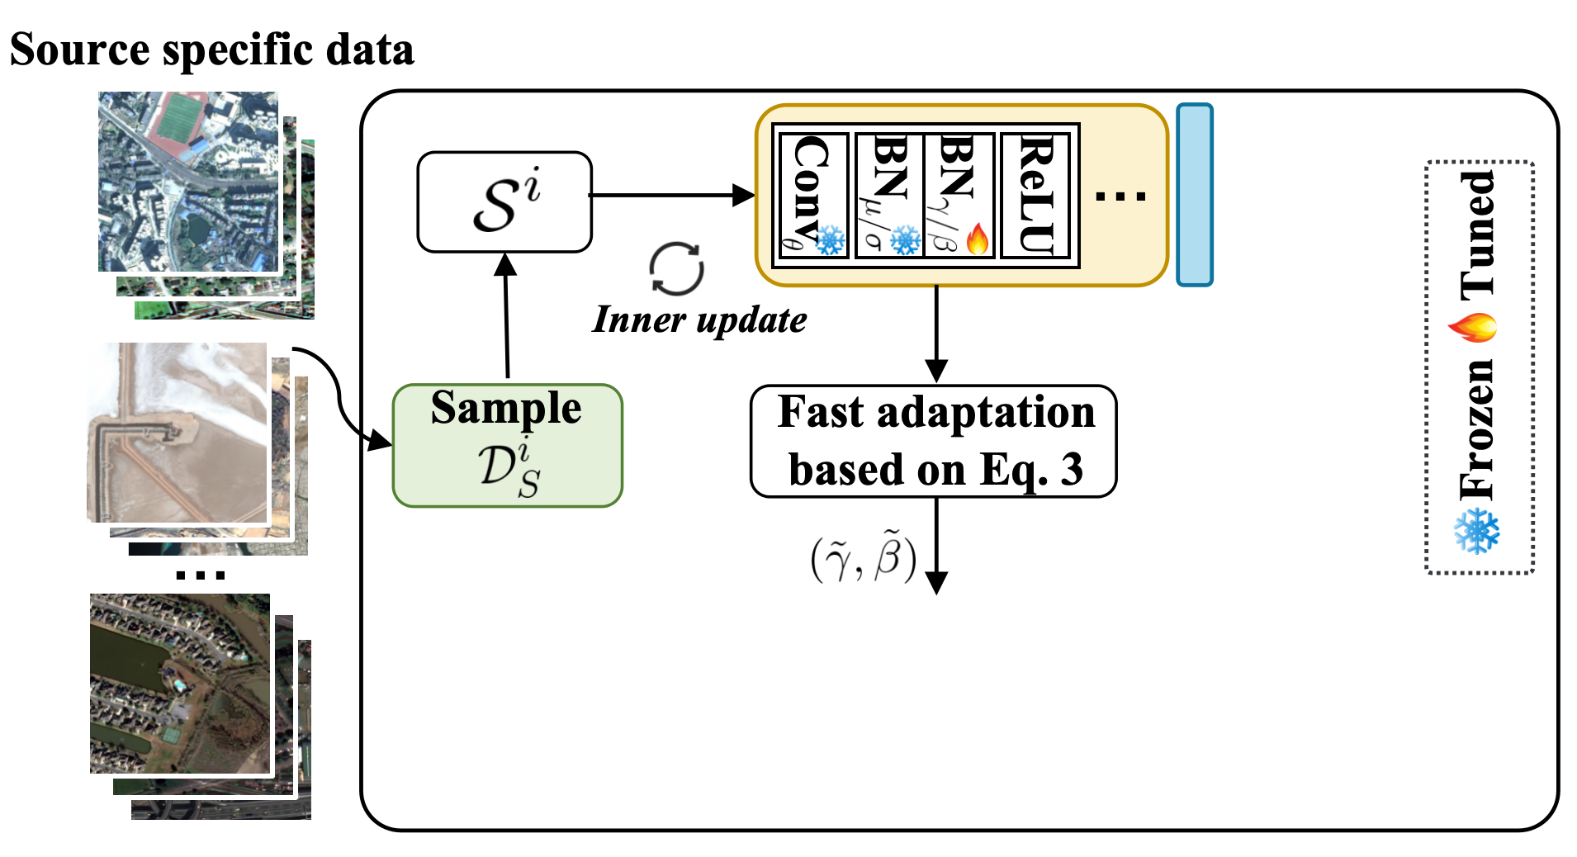
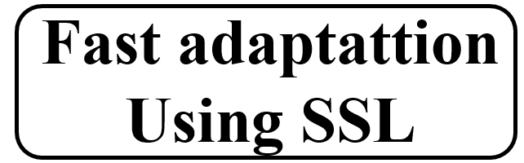
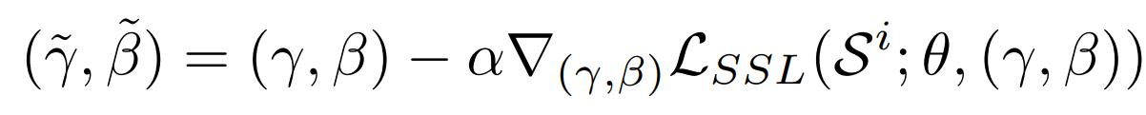
Learning to Adapt (second stage)
Task formulation: adapting to every domain using a few unlabeled data

Slide 9
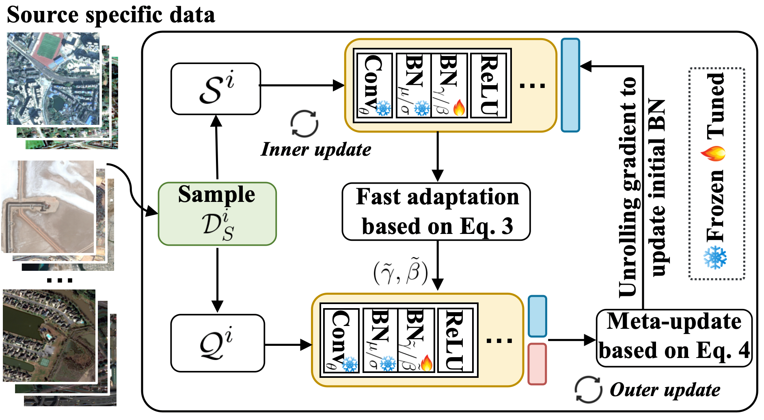
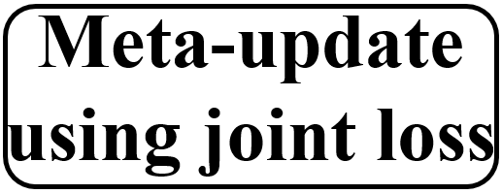
Learning to Adapt (second stage)
Meta-objective: evaluate the adapted affine parameters on a disjoint set in the task.

Slide 10
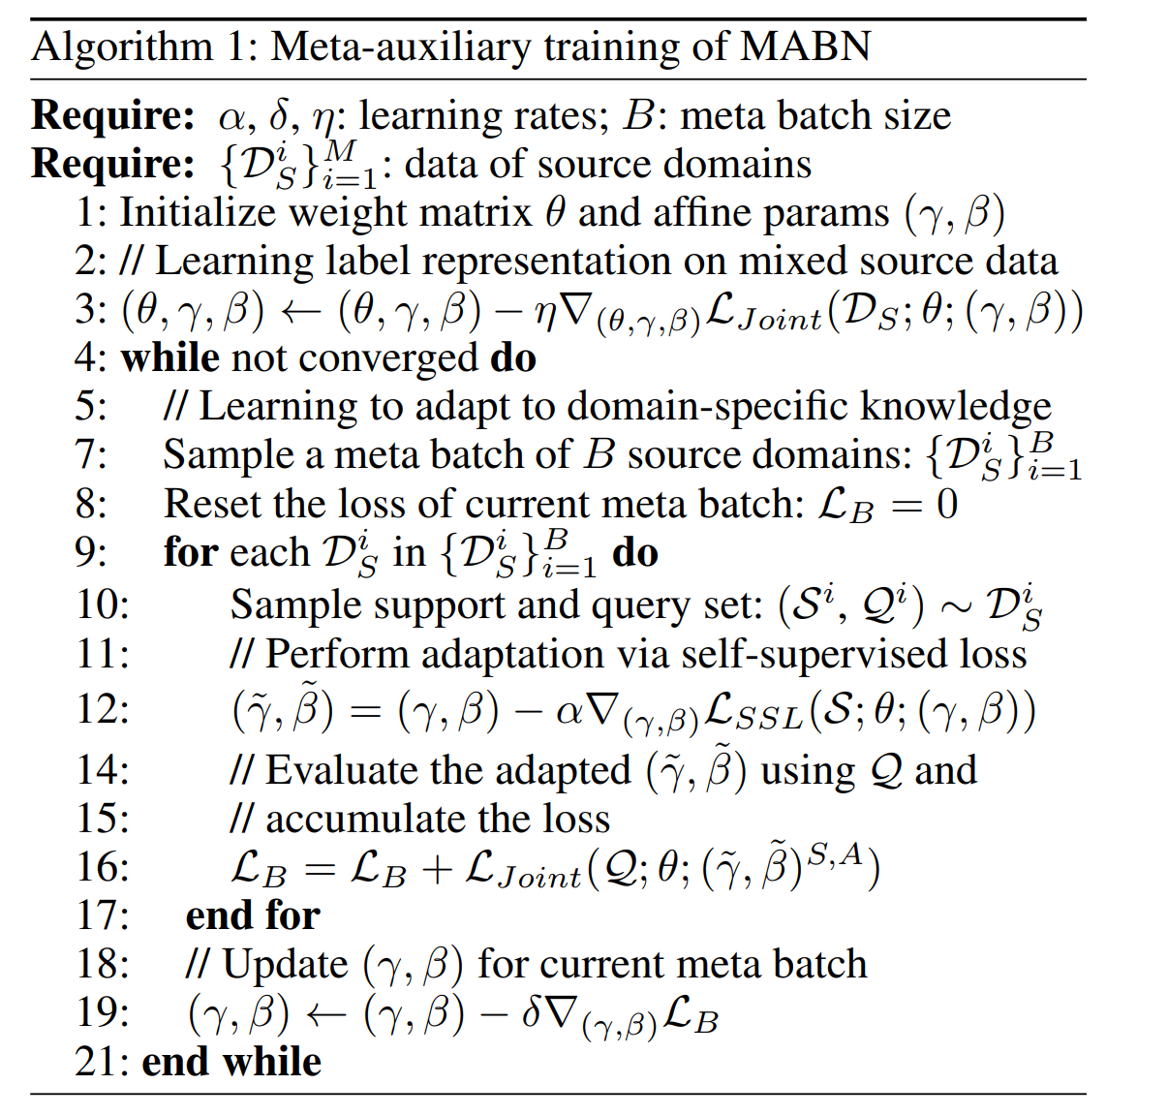
Learning to Adapt (second stage)
Training and evaluation protocol alignment via simulation
Learning objective alignment

Slide 11
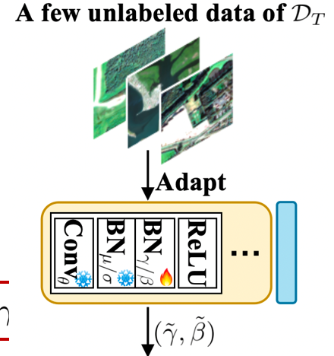
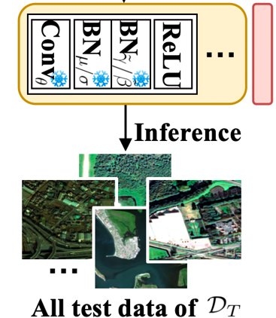
Test-time Domain Adaptation on Unseen Domains
Acquire domain-specific knowledge via auxiliary branch followed by inference

Slide 12

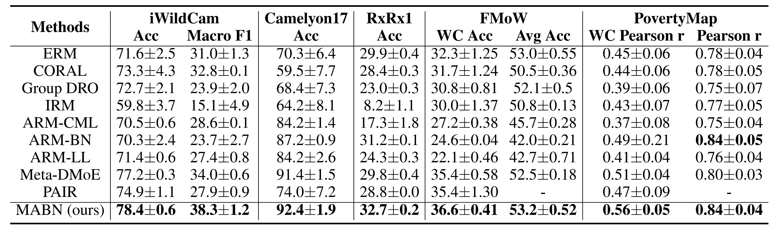
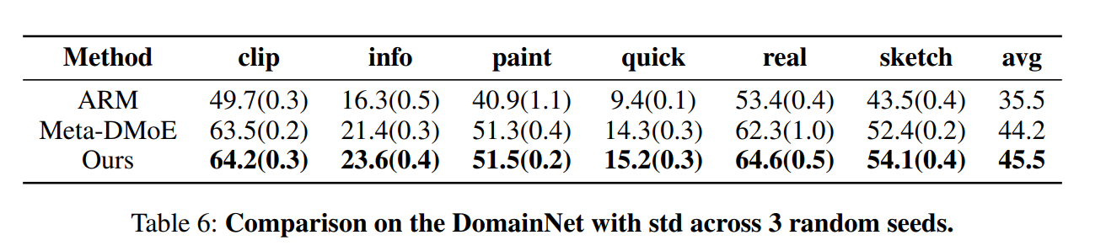
Results: comparison with the state-of-the-art
WILDS benchmark:
Large number of unseen target domains.
Data imbalance at both domain- and class-level.

Slide 13
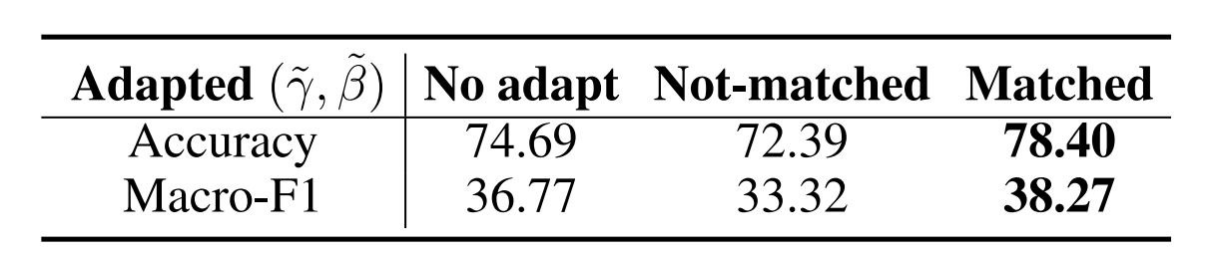
Evaluation on Domain-specific Knowledge
iWildCam benchmark:
48 OOD unseen target domains.
Compute adapted Affine Parameters for each domain.
Random shuffle them

Slide 14
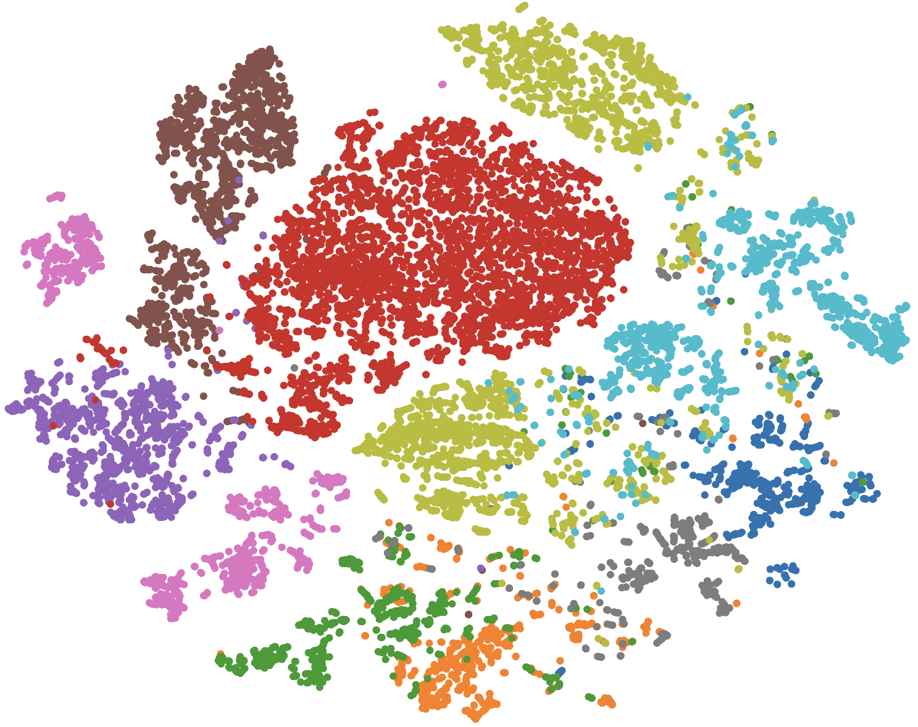
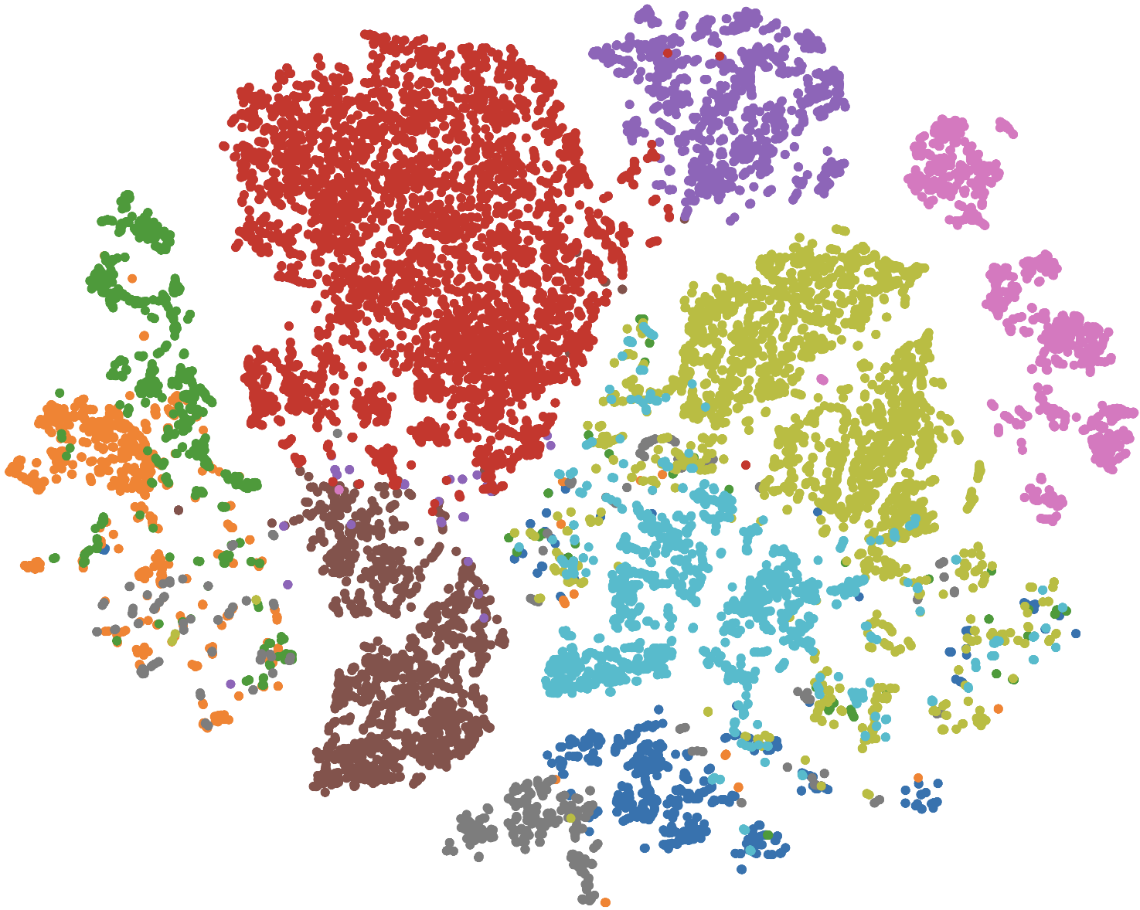
Visualizations: representation of target domain partial-classes from iWildCam
Left: feature distribution before adaptation
Right: feature distribution after adaptation

Slide 15
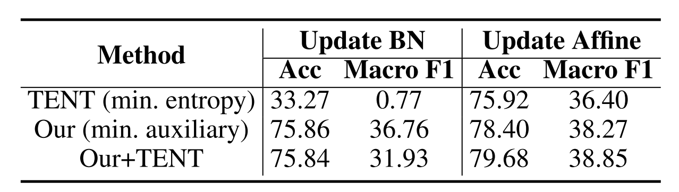
Integration with other TTA Method
Adapt to domain first.
Further improvement with instance-based TTA

Slide 16
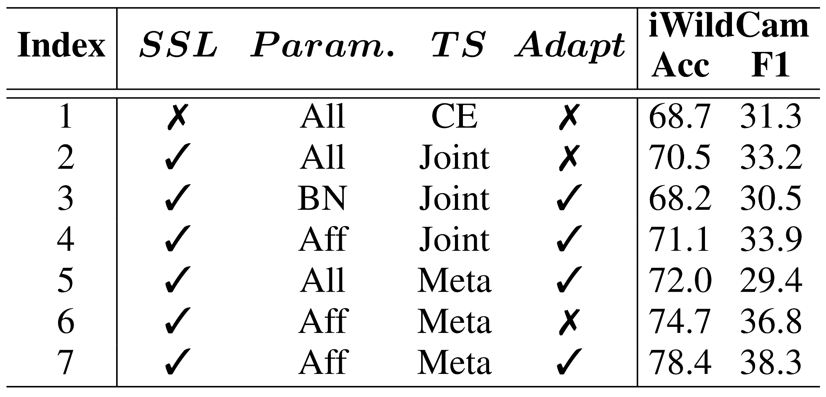
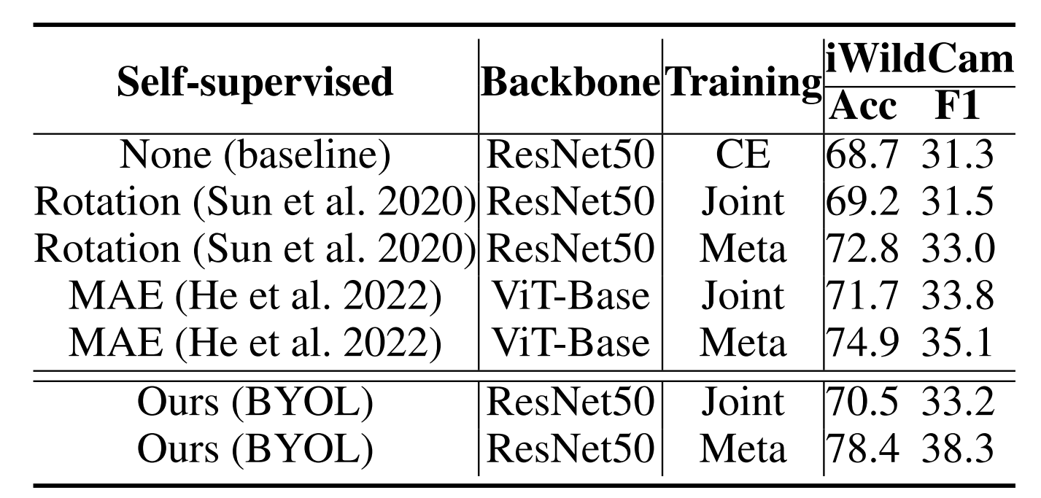
Ablation
Evaluation on each component.
Evaluation on SSL methods.

Slide 17
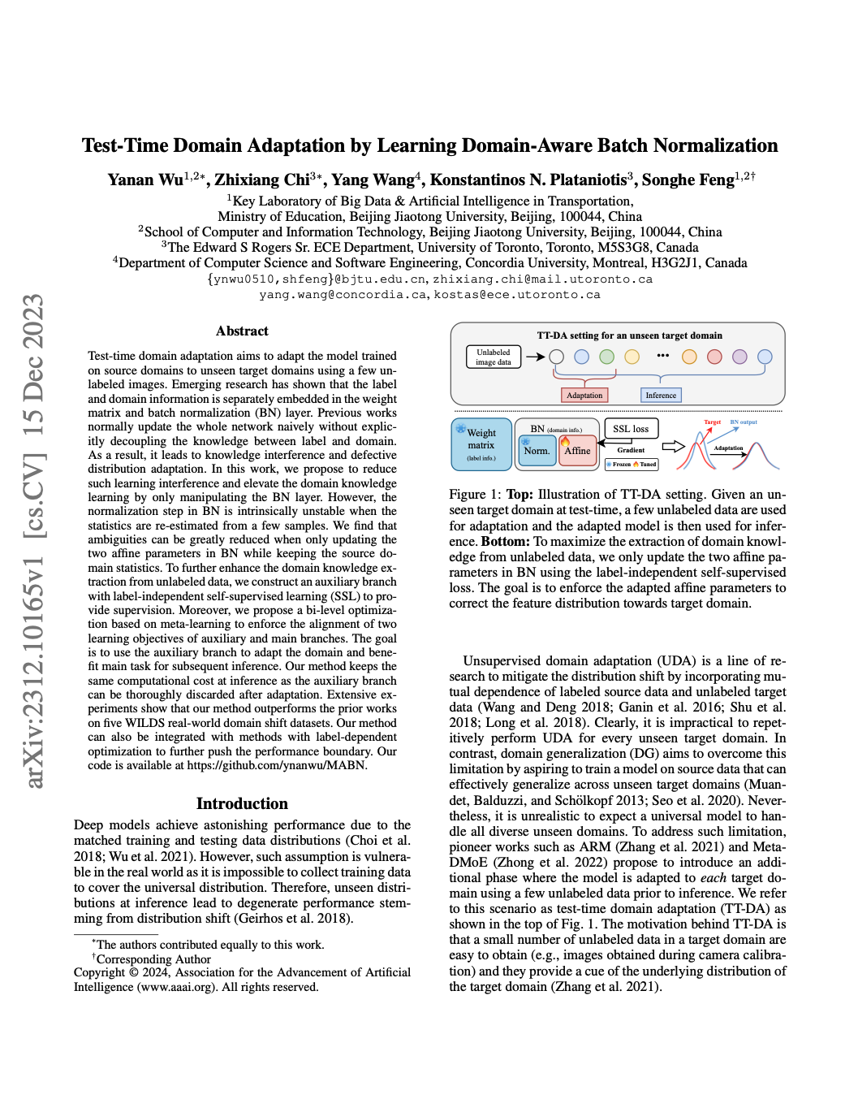
Thanks!
Poster #386
Test-Time Domain Adaptation by Learning Domain-Aware Batch Normalization
Webpage: https://chi-chi-zx.github.io/MABN_project
Code: https://github.com/ynanwu/MABN

